Slide 1
Visual Analytics
Session 7: From shallow to deep learning
(Introducing TensorFlow)
Ross Deans Kristensen-McLachlan
rdkm@cas.au.dk

Slide 2
Course outline
1. Introducing Visual Analytics
2. Basic image processing
3. More image processing
4. Convolutional kernels
5. Image classification 1
6. Image classification 2
7. From shallow to deep learning
8. Convolutional neural networks
9. Pretrained CNNs and transfer learning
10. Image embeddings
11. Project presentations
12. Text-to-image models
13. Project development

Slide 3
Plan for today
Catch up
1. Deep learning challenges
Complexity in neural networks
Backpropagation and vanishing gradients
Activation functions
Introducing TensorFlow
2. Code-along session
A simple feed-forward neural network using TF
No assignment this week

Slide 4
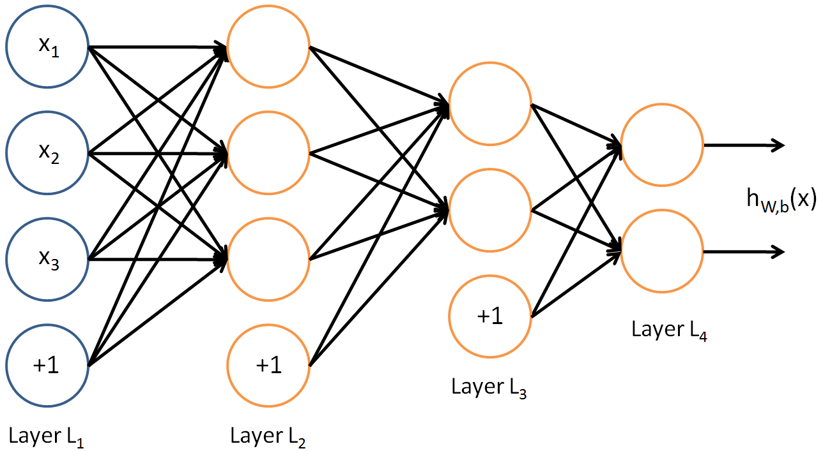
Model complexity
Last week we discussed the schematic outline of a feed forward neural network
In this example, every node in any given layer is connected to every node in the next layer
A fully-connected network
The full MNIST image data are 28*28 pixels = 784, meaning 784 input features + 1 bias feature
785 input nodes
If the shape of layer 1 is 256, that’s 200,960 trainable parameters

Slide 5
Model complexity
Larger feature spaces result in a larger set of trainable parameters in the model
In fully connected networks, the complexity can grow rapidly!
Can you think of one possible – and reasonably simple – way to solve this?
Think about some of the work we’ve already done in Lang + Visual Analytics

Slide 6
Model complexity
Larger feature spaces result in a larger set of trainable parameters in the model
In fully connected networks, the complexity can grow rapidly!
Can you think of one possible – and reasonably simple – way to solve this?
Think about some of the work we’ve already done in Lang + Visual Analytics
Possible solution: reduce feature space
E.g. sklearn MNIST ‘digits’ data are only 8*8 pixels
If layer 1 has 32 nodes
64*32 = 2,048 trainable parameters

Slide 7
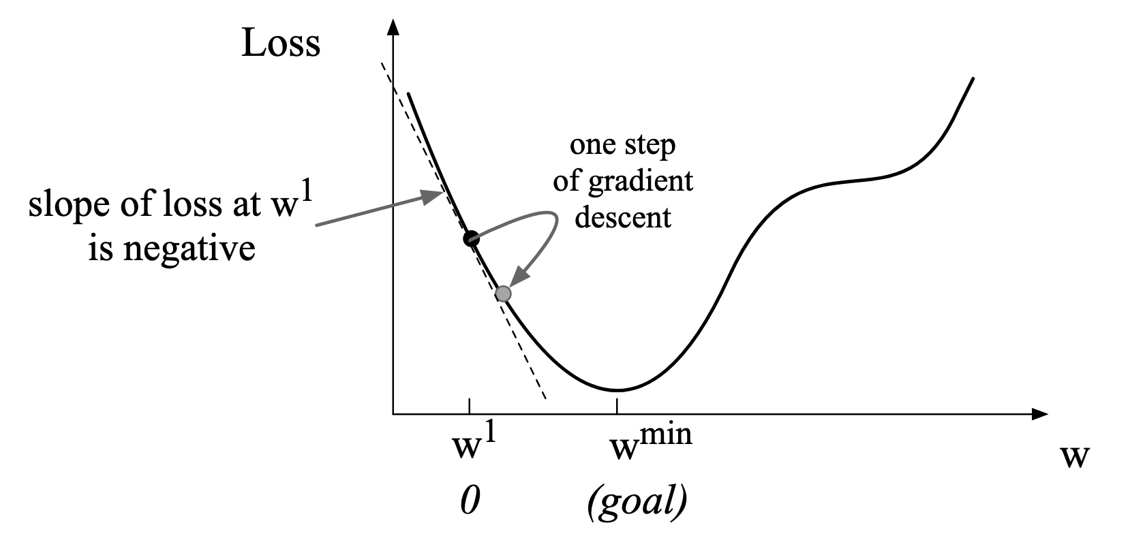
Learning from mistakes
A second problem is a bit trickier
Think about how a logistic regression classifier ‘learned’ by trying to find the minimum of some loss function

Slide 8
Learning from mistakes
A second problem is a bit trickier
Think about how a logistic regression classifier ‘learned’ by trying to find the minimum of some loss function
It did this by calculating the gradient of the slope of the loss function and used that to figure out how to tweak weights
This can be optimised using stochastic gradient descent (SGD)
How does this relate to neural networks?

Slide 9
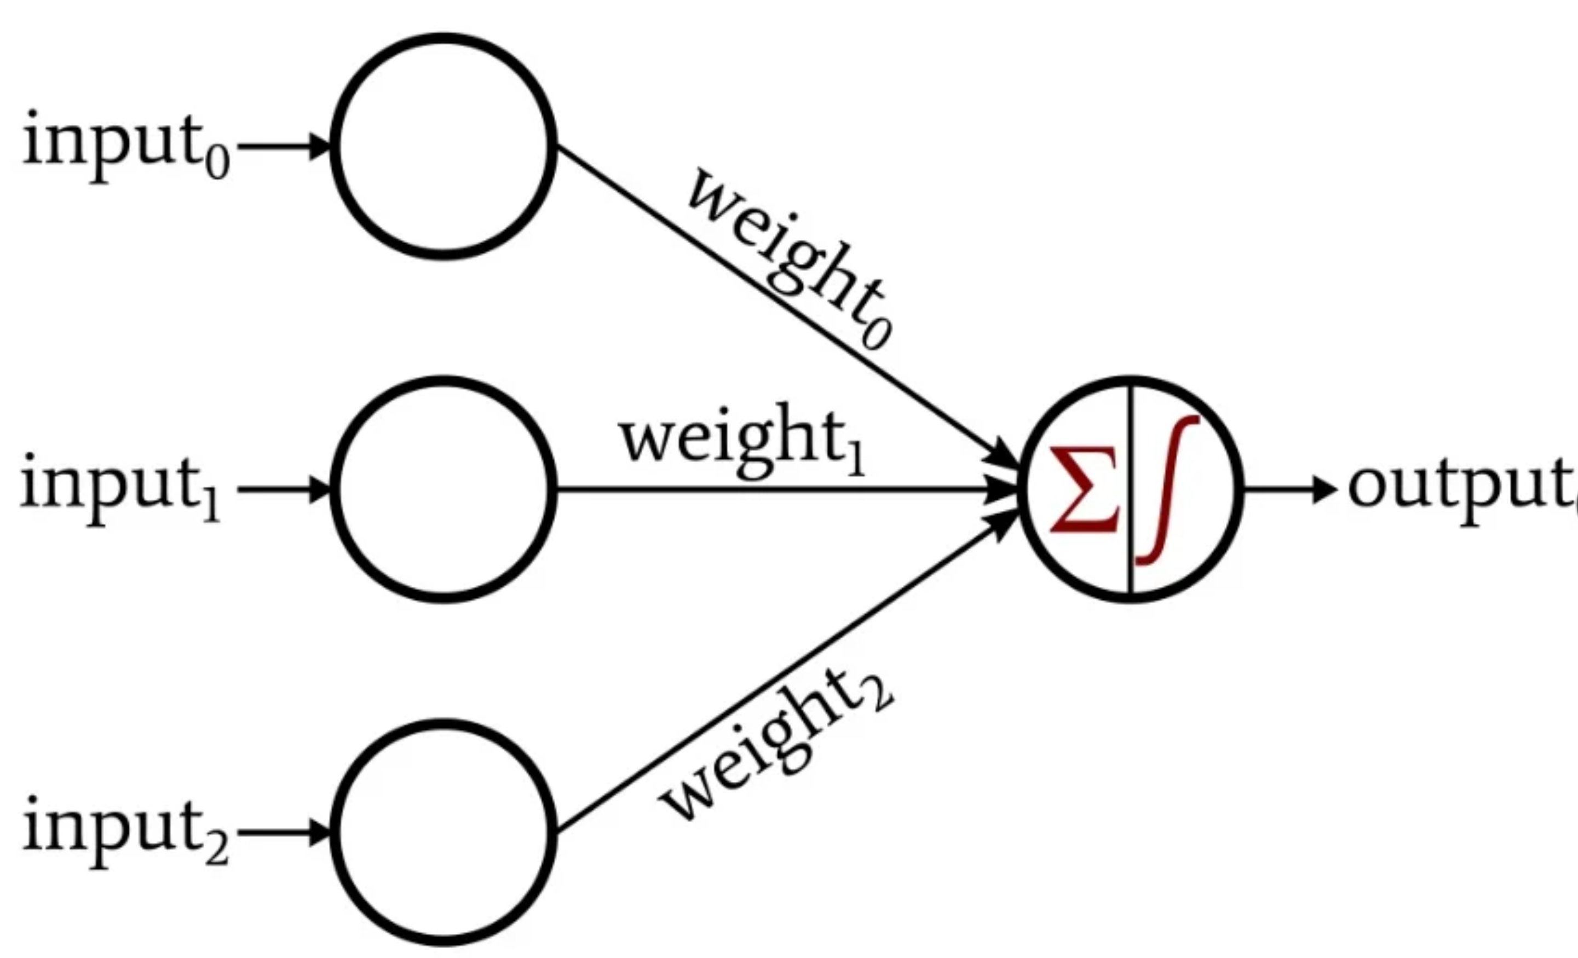
Learning from mistakes
Remember there is a fundamental analogy between a logistic regression classifier and single neuron
A fully-connected, feed-forward neural network using a sigmoid activation function for each neuron is just a really just bunch of logistic regression models
Neural networks learn in a similar way by calculating gradients of loss functions at each node across each layer
These are then sent back through the network through a process known as backpropagation

Slide 10
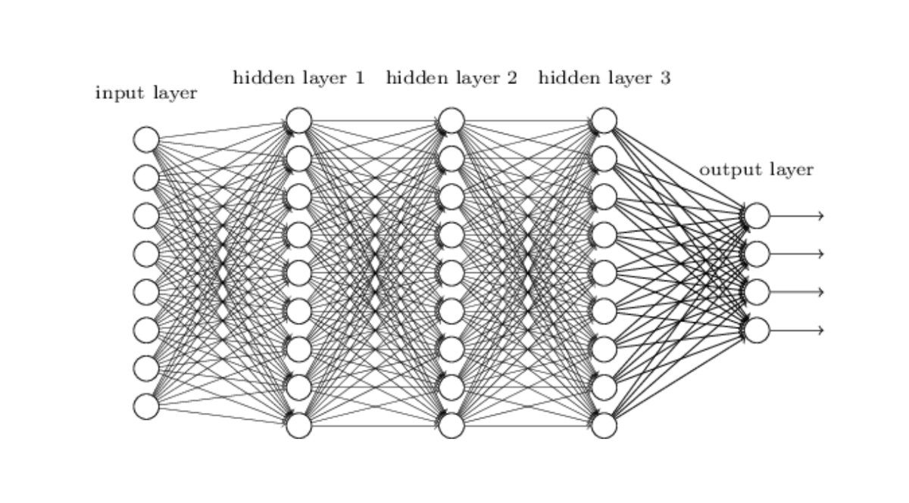
Backpropagation
Backpropagation uses some nifty calculus to tune weights but the process is just like with logistic regression
Information is fed forward through the network from the input to output layer
We use the gradients of loss functions from the output layer back to the input layer through every node in each hidden layer and adjust the weights
Adjustments to weights are controlled by SGD or a similar optimization algorithm
Depending on model complexity, this can be expensive to train!

Slide 11
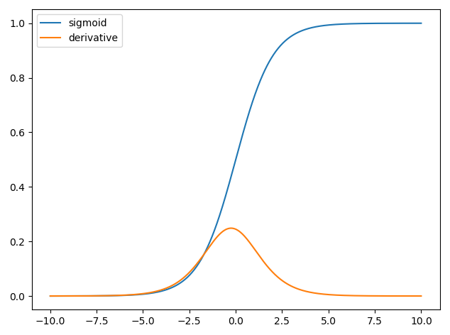
Back to the logistic function
A final issue arises when we consider the mathematical properties of the logistic activation function
We don’t need to dwell on the maths – we can consider the visual representation to the right
What we find is that for high and low values of x the logistic activation function has gradients approaching 0
Why might this be a problem?

Slide 12
Vanishing gradients
If the gradient of a loss function approaches 0, then the model is not able to adjust weights
In the context of deep neural networks, this a bit of an issue
As the loss is propagated back through the network, the gradients grow increasingly small
Ultimately, the model becomes unable to learn any more
This is known as the vanishing gradient problem

Slide 13
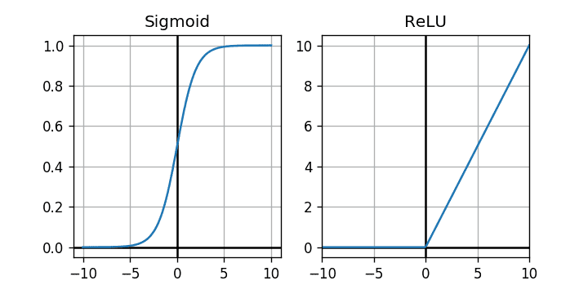
Activation functions
This problem arises as a result of the mathematical properties of the logistic function
One way to solve the vanishing gradient problem is to use a different activation function
A common activation function that we’ll be seeing a lot of is called ReLU
Rectified linear unit
ReLU = max(0, X)
For x<0, ReLU always returns 0
For x>0, ReLU returns X
Hence, gradient is always either 0 or 1
No vanishing gradients!

Slide 14
Summary
Neural networks are costly to train for a number of reasons
Trainable parameters grow exponentially with feature space
Difficult to learn and optimise
Even if we have time to spend, deep networks can suffer from the vanishing gradient problem
To solve all of these problems, we’d need to hand code all of the optimisations into our Neural Network class, define our own ReLU activation function, optimise for performance, etc, etc..
Another solution is to use a library which does all this for us…

Slide 15
Break

Slide 16

Introducing TensorFlow
For the rest of this module, we’ll be making extensive use of a package called TensorFlow
TF from here on
Designed and maintained by the AI team at Google
Free, open-source framework for machine learning, with a particular emphasis on deep learning with neural networks
I recommend spending some time on their website and Github repo
https://github.com/tensorflow/tensorflow
https://www.tensorflow.org/

Slide 17
Introducing TensorFlow
TF is a huge, highly sophisticated, complex, confusing, fast, efficient, and flexible framework
Models can be trained in Python and used in other languages for inferencing
Widely used in industry and research – it’s kind of a a big deal
It’s built upon two basic kinds of computational objects – tensors and computational graphs

Slide 18
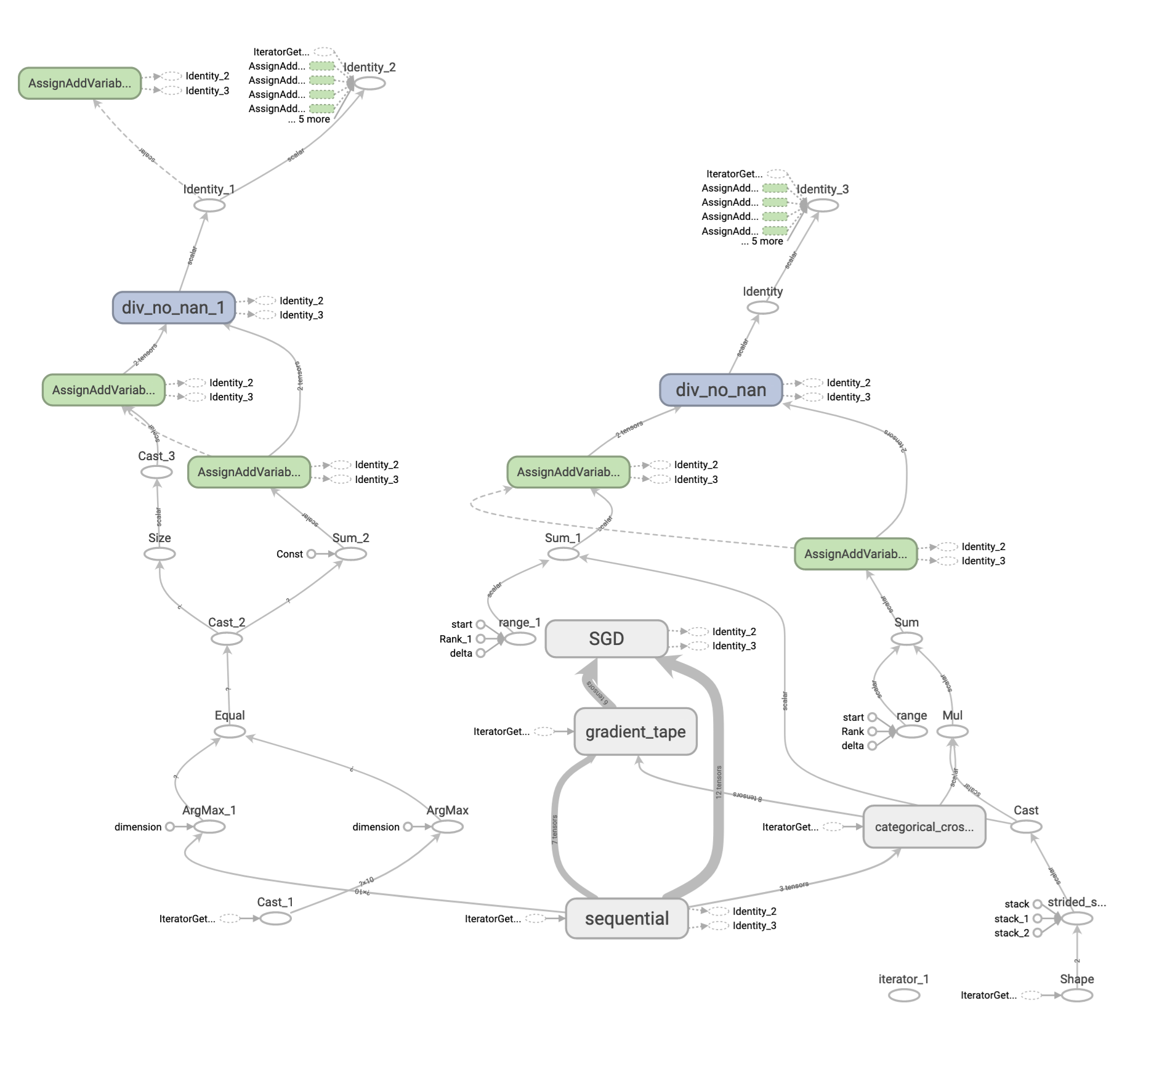
Why use computational graphs?
So we are defining how data should flow through the graph
Models can be trained more efficiently through optimizing and eliminating redundancy and simplifying arithmetic
During back propagation, the computer doesn’t have to figure out what was performed at any given step – it can just check the graph!
So we get the added benefit of automatic differentiation of gradients

Slide 19
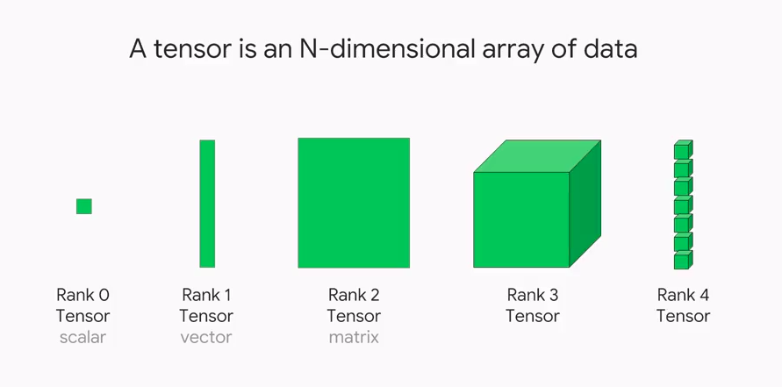
But what is a tensor?
When we’ve been doing machine learning, we’ve been representing data and weights as numpy arrays
Mathematically, a 1D array is a vector
[1, 2, 3, 4, 5, 6]
A 2D array is a matrix
[[1 ,2],
[3, 4],
[5, 6]]
For our purposes a tensor is a generalization of matrices in N-dimensional space

Slide 20
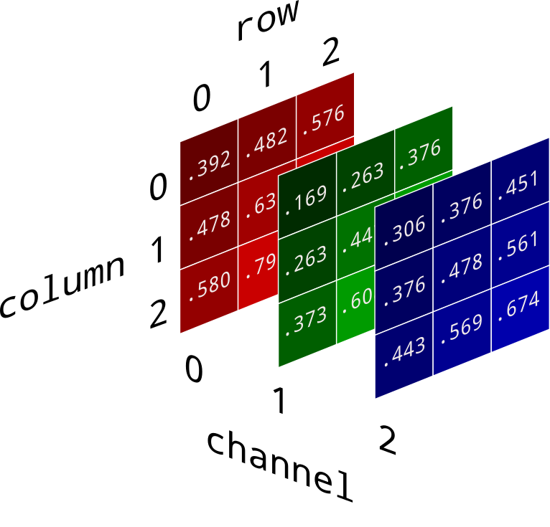
An old example
Think back to how a colour digital image is actually represented
It’s not a single 2D array of numbers
Instead, it’s a ‘stack’ of 3 2D arrays, each of which corresponds to a different colour channel
In this respect, a colour digital image is represented as a tensor of rank 3
In principle, you already know what a tensor is - no need to overthink it!

Slide 21
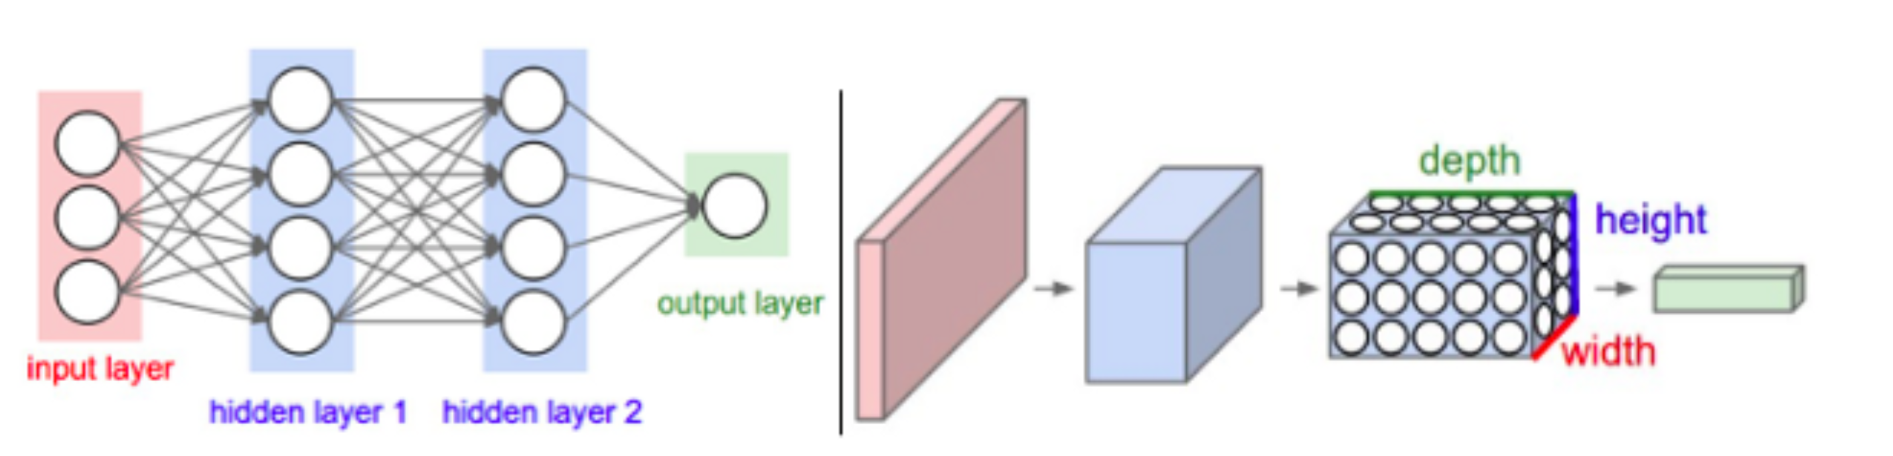
Tensors and graphs
TF enables you to build dataflow graphs and structures to define how data moves through a graph by taking inputs as tensors
It allows you to construct a flowchart of operations that can be performed on these tensors
In the case of training neural networks, the various weights between layers are also now represented as tensors
This will be immensely valuable when we look at convolutional neural networks for image classification

Slide 22
Summary
TF is a powerful machine learning framework which is built upon the idea of computational graphs and tensors
Computational graphs define the operations performed on units of data
These units are tensors, which are generalizations of arrays in N-dimensions
TF allows us to efficiently train models during both the feed-forward and backpropagation phases
Similarly the use of computational graphs allows models to scale efficiently
Thankfully, it all comes with a high-level API which makes it easy to train models
This is what we’ll be doing in the code along session

Slide 23
Break
And head over to UCloud

Slide 24

https://forms.office.com/e/3mAH9BHUxJ

